Slide 1
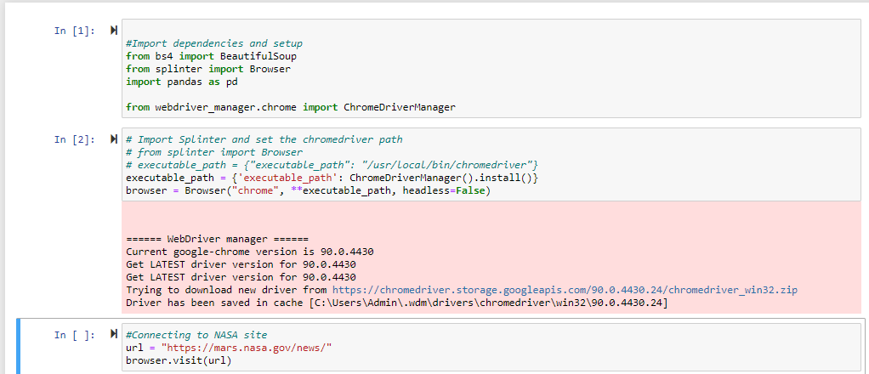
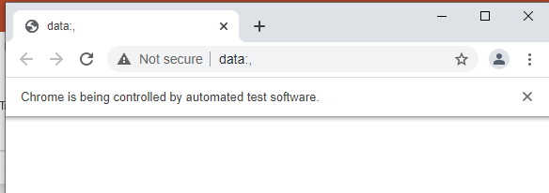
Detail of splinter functionality invoked and controlling Chrome to scrape

Slide 2
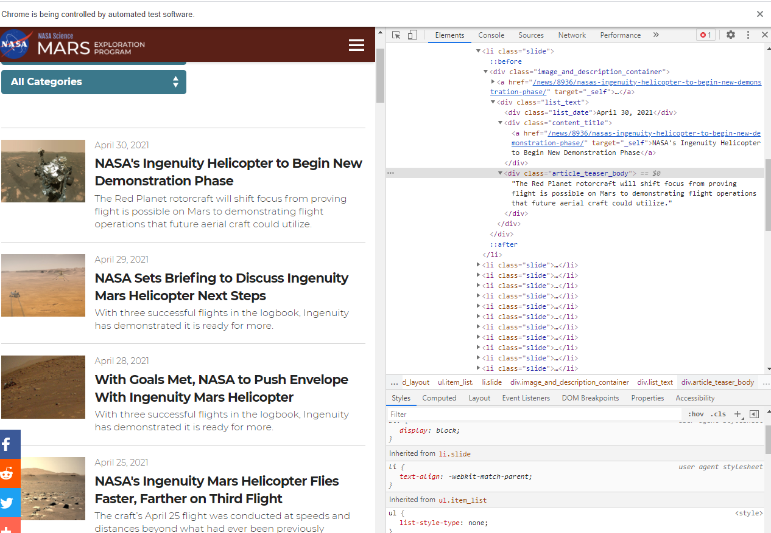
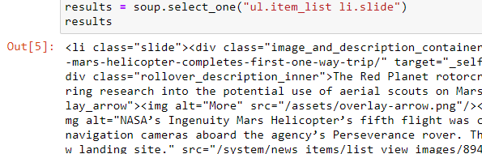
Select_one instead of find. CSS element in inspect
After checking documentation, I decided to use "select" function instead of "find".
It gives you a different possibility. It lets you navigate through an HTML tree using the CSS selectors which have easier syntax.

Slide 3
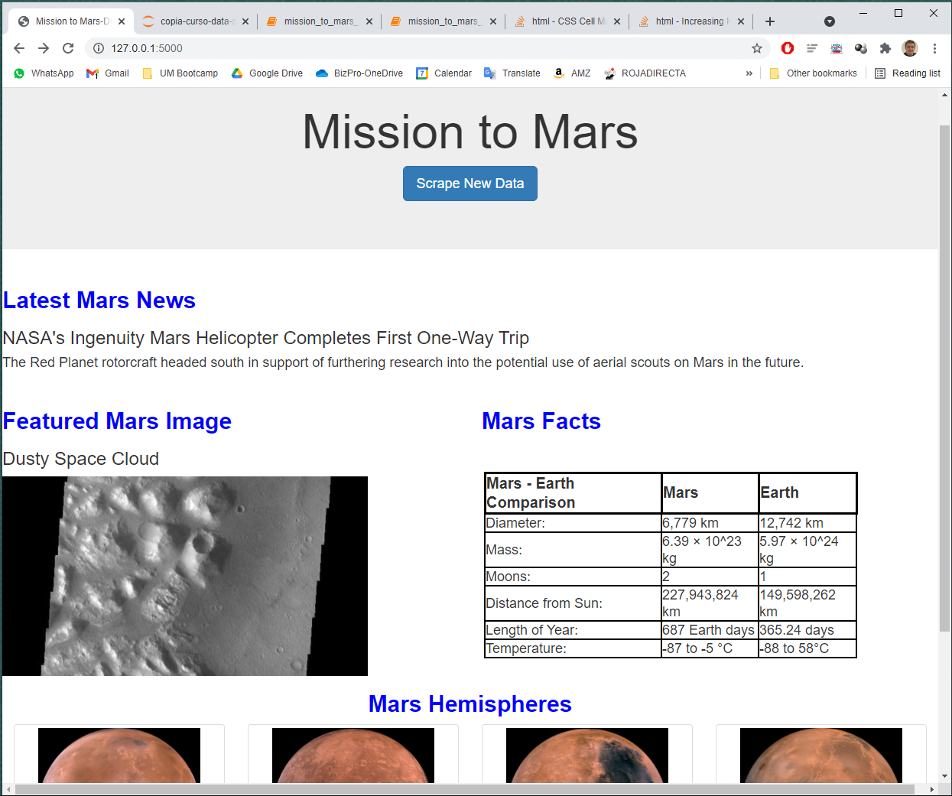
Detail of web page obtained with app.py

Slide 4
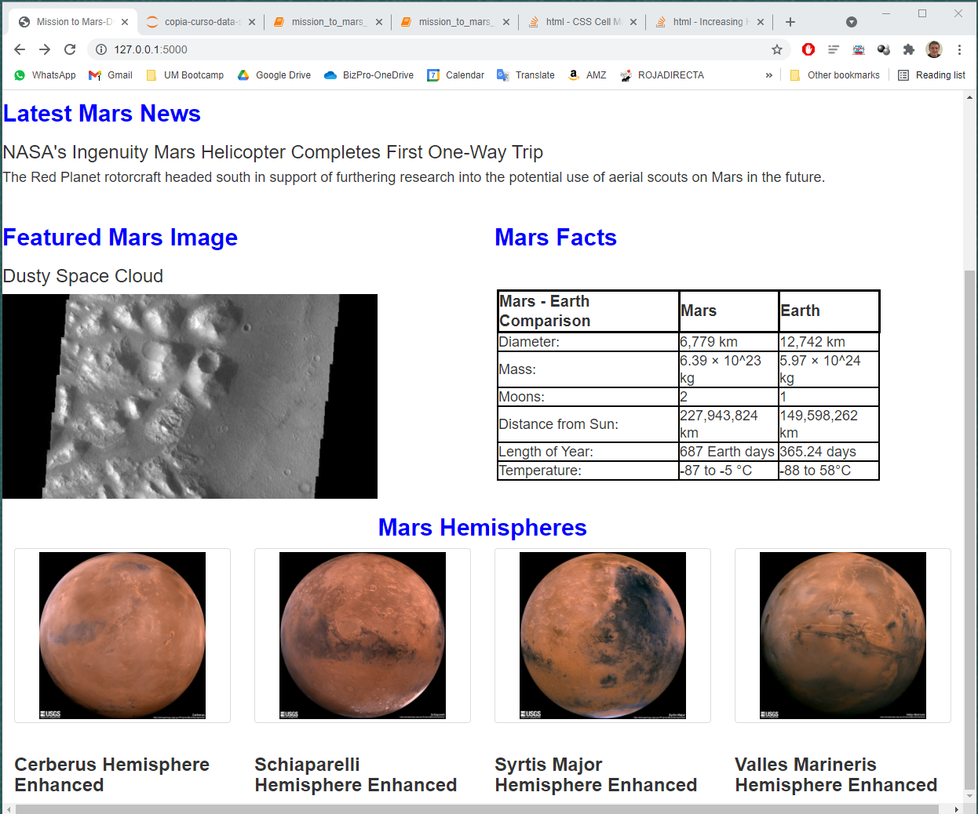
Detail of web page obtained with app.py

Slide 5
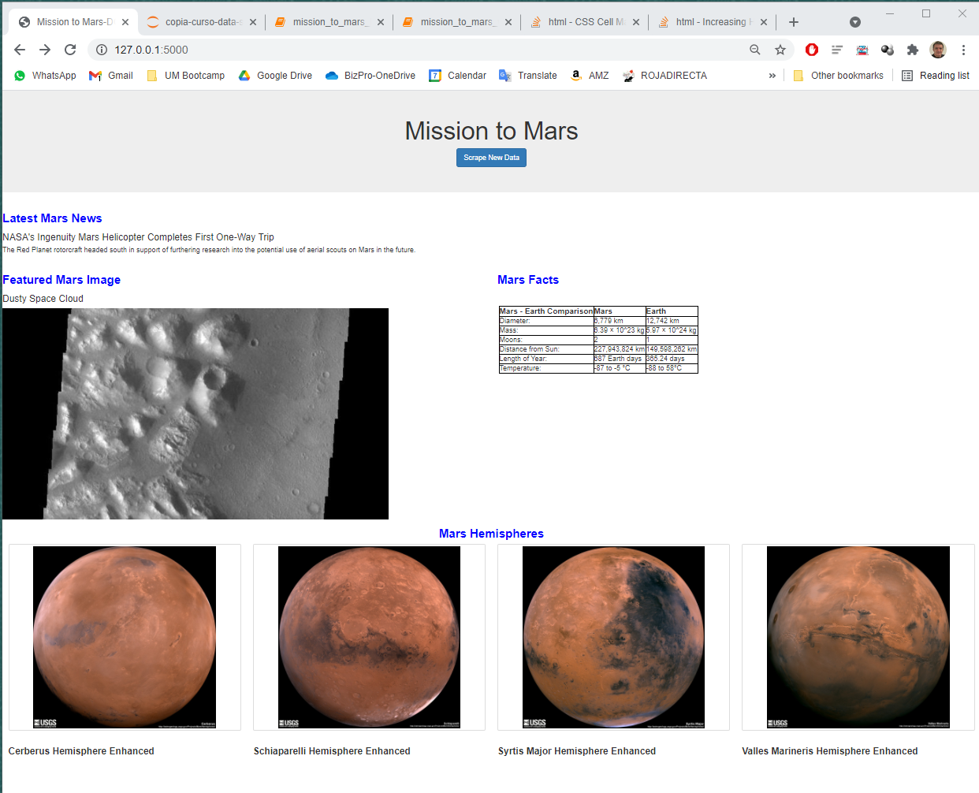
Full page zoomed

Slide 6
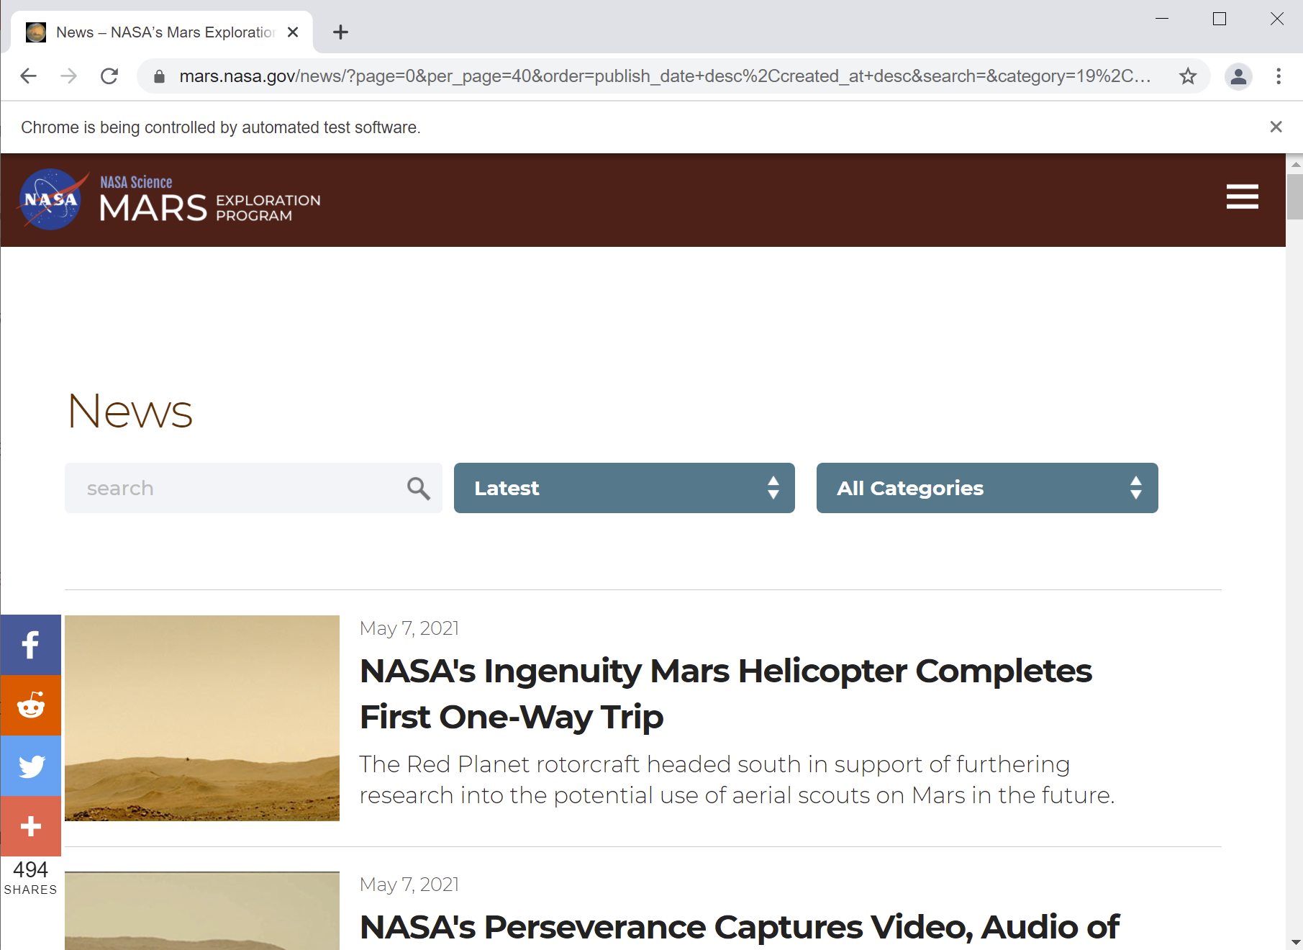
Visit page by Splinter functionality while scraping to get NEWS

Slide 7
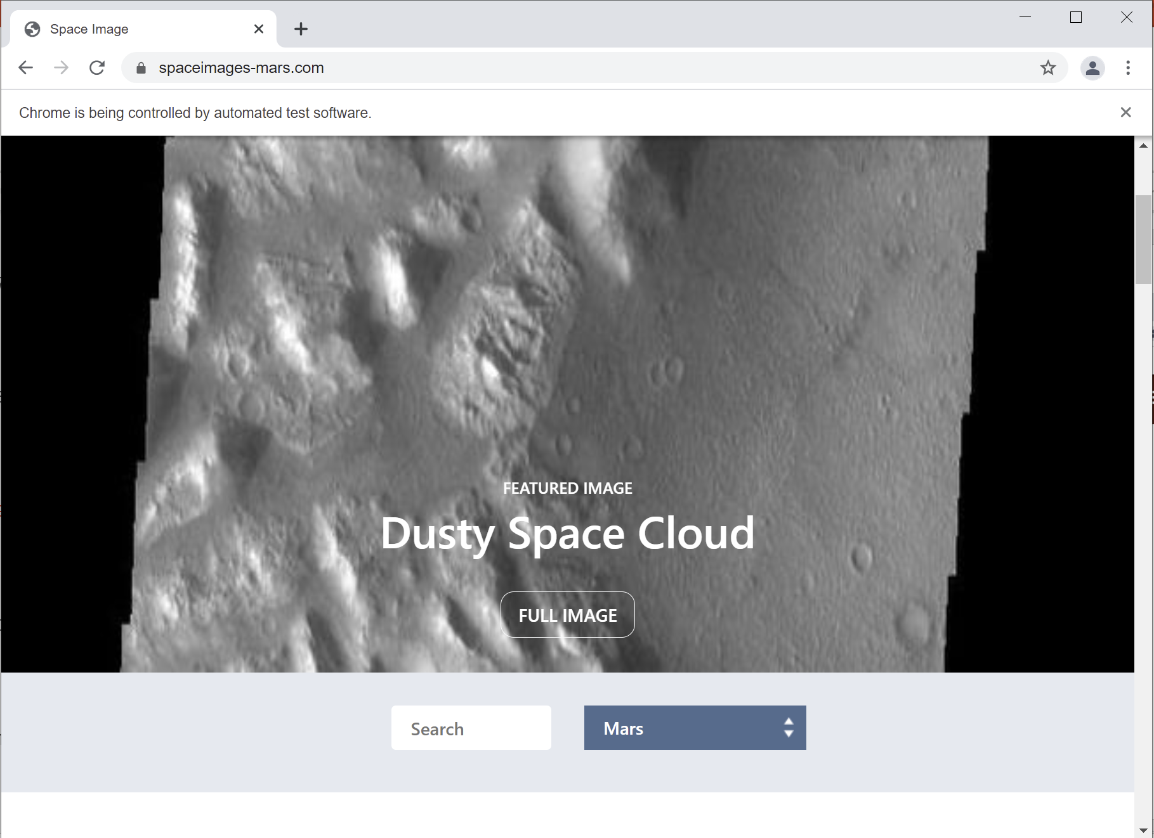

Visit page by Splinter functionality while scraping to get IMAGES

Slide 8
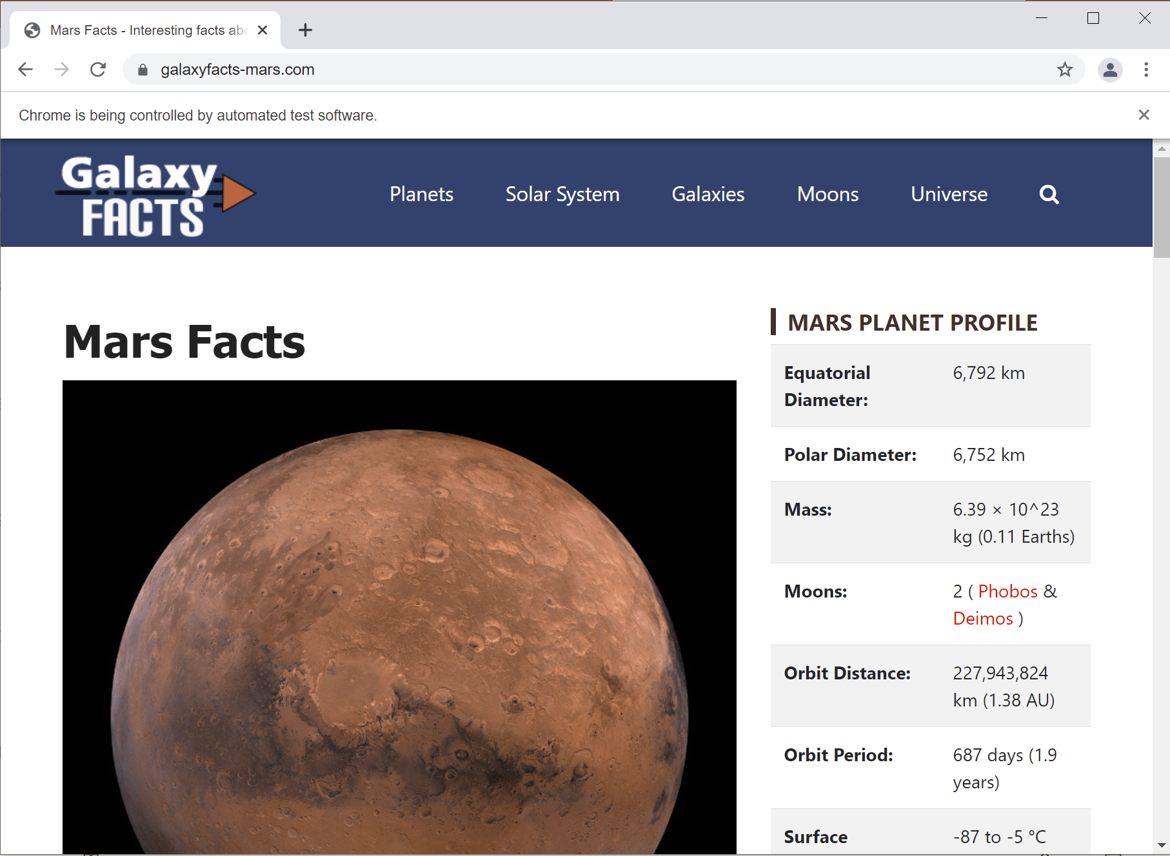
Visit page by Splinter functionality while scraping to get FACTS

Slide 9
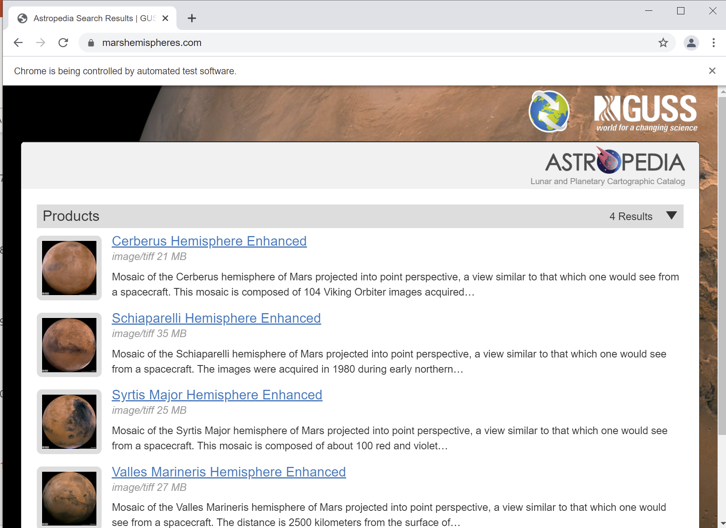
Visit page by Splinter functionality while scraping to get HEMISPHERES INFO & IMAGES

Slide 10
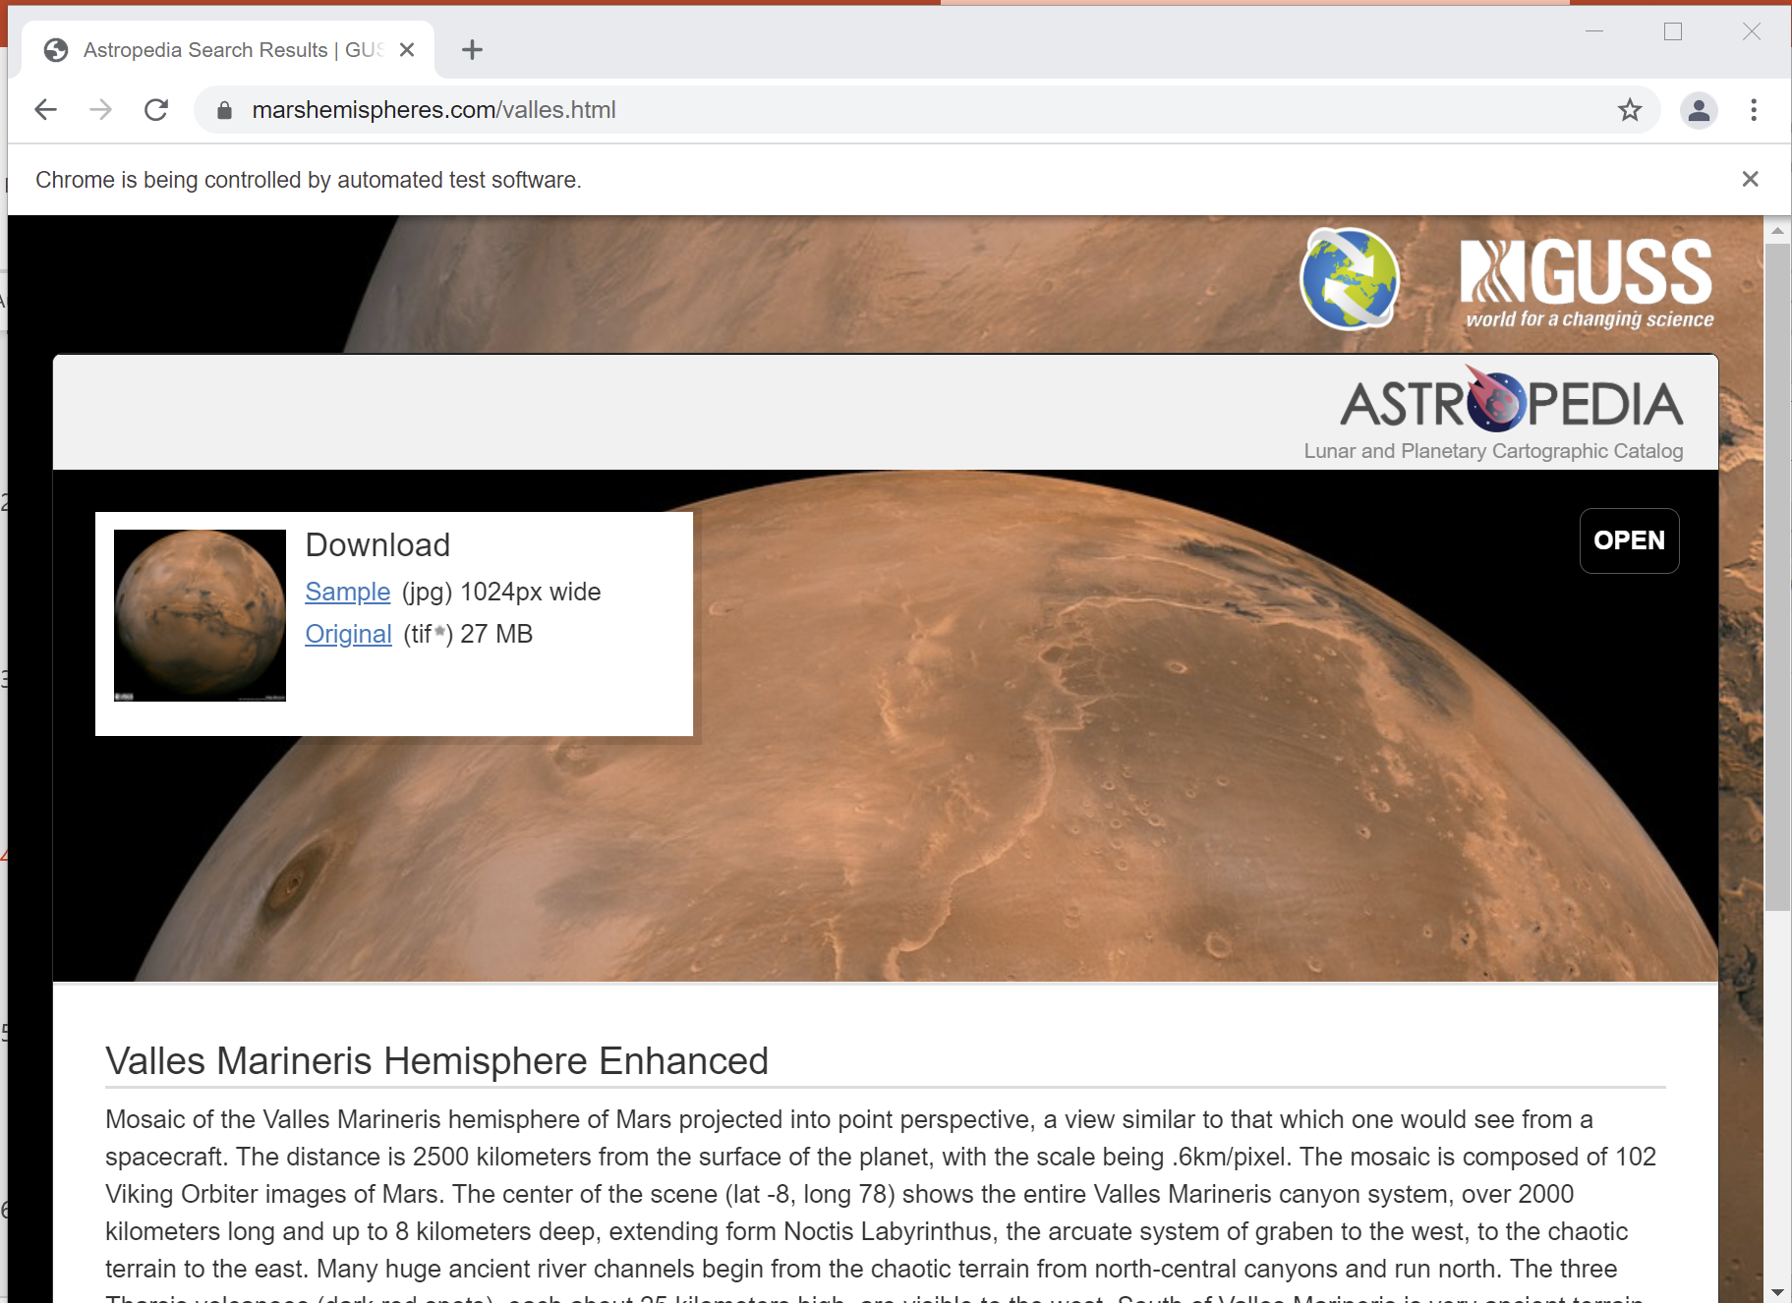
Visit page by Splinter functionality while scraping. Final page after navigation, before closing browser

Slide 11
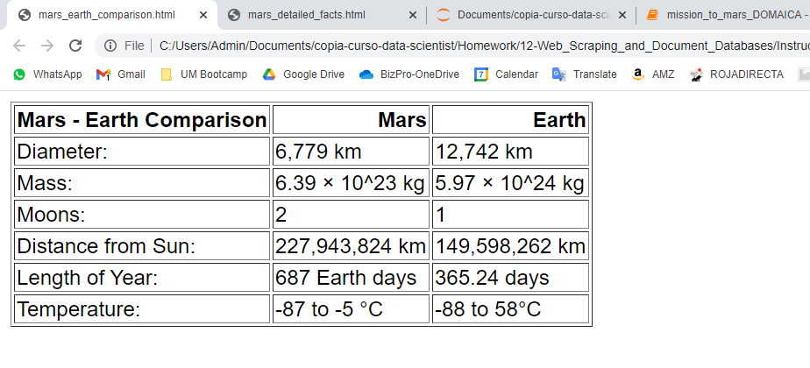
Detail of obtained HTML table mars-earth comparison

Slide 12
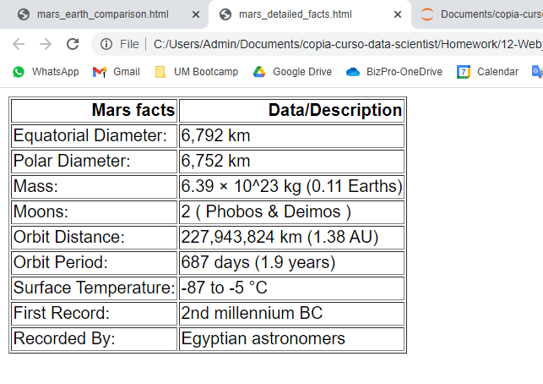
Detail of obtained HTML table mars facts

Slide 13
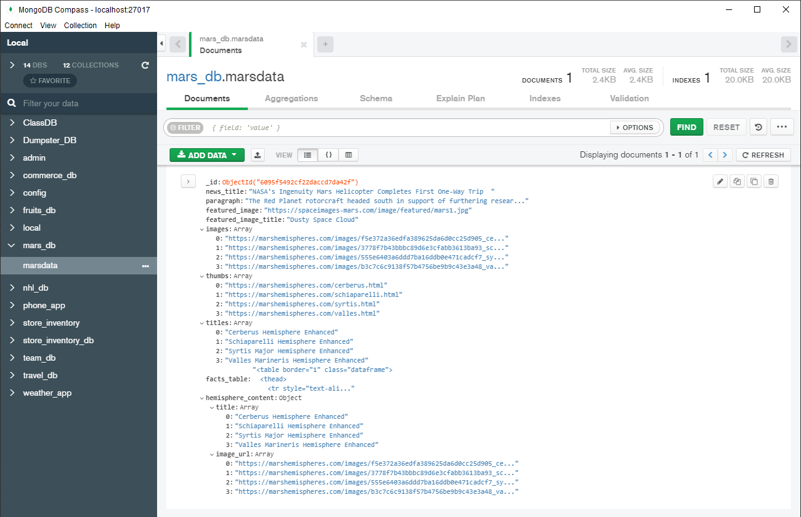
mars_db & marsdata collection inserted by scrape_mars

Slide 14
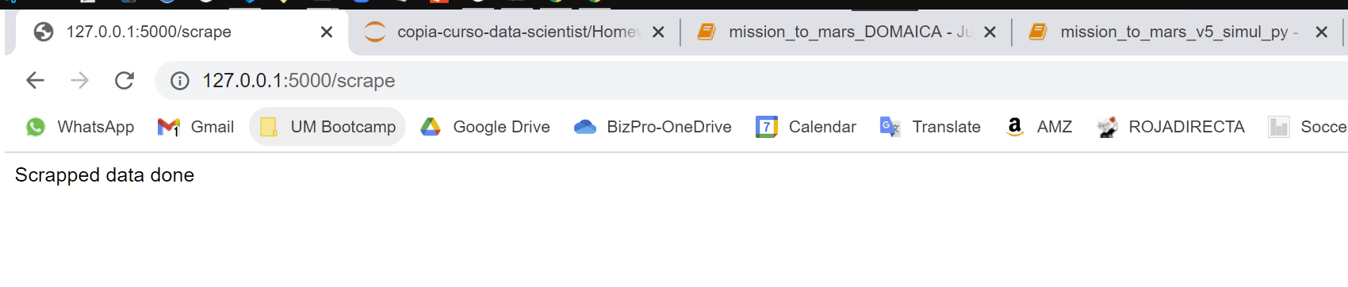
Message scrapping from html through app.py & scrape_mars.py successful

